Slide 1


King Saud University
Software Engineering Department
SWE 485 – Selected Topics in Software Engineering
Car Maintenance
Tracking system
Sara Alshuwaier 444200957
Reema Almunasser 444201088
Sadeem Alsayari 444201182
Leen Alohali 444200882
Noof Alkhalifa 444200886
1ts Semester | Fall 2025-2026

Slide 2


01
Problem Statement
Lack of maintenance reminders and tracking causes delayed servicing, leading to:
Unexpected car breakdowns
Increased repair costs
Reduced vehicle lifespan

Slide 3

02
Objectives
Simplify and automate vehicle maintenance tracking
Predict maintenance needs in advance
Enable proactive rather than reactive maintenance
Use data-driven insights to analyze:
Maintenance history
Vehicle condition
Environmental factors

Slide 4
03
User Value Proposition
Improves user experience through automated tracking and proactive maintenance reminders.
Business & ROI Potential
Supports cost savings, better resource planning, and long-term value through optimized maintenance scheduling.
Operational Impact
Reduces unexpected breakdowns by enabling early identification of maintenance needs through predictive insights.
Cost Efficiency
Helps lower maintenance and repair costs by preventing major failures and reducing emergency repairs.
Business Value
Asset Value
Extends vehicle lifespan by supporting timely and data-driven maintenance decisions.

Slide 5

04
Data Source
Key Features
Collection Methods
  Dataset obtained from Kaggle
  Logistics Vehicle Maintenance History Dataset
  Represents historical records of vehicle maintenance activities
  Maintenance frequency
  Type of maintenance performed
  Vehicle condition indicators
  Time-based features (dates, intervals)
  Historical maintenance logs
  Recorded service and repair events
  Time-stamped vehicle records
  Collected from operational logistics data
Data Overview

Slide 6
05
Process/Approach
Data Cleaning
Handle missing values, remove duplicates, normalize data
EDA (Exploratory Data Analysis)
Visualize distributions, statistical summaries, and class balance
Supervised Learning
Train models to predict advice using Gradient Boosting Decision Trees (GBDT) algorithm and Random Forest (RF)
Unsupervised Learning
Apply clustering to find patterns and improve recommendations
Generative AI (GAI)
integrate TinyLlama and Microsoft Phi-2 models to generate detailed advice

Slide 7









06
Tools Used
python
Pandas & NumPy
Matplotlib & Seaborn
The main programming language used for data analysis, machine learning modeling, and Generative AI integration.
Python libraries used for data cleaning, manipulation, and numerical computations
visualization python libraries used for creating charts, graphs, and statistical plots
Scikit-learn
Transformers
Google Colab & GitHub
Machine learning python libraries Used to build and evaluate supervised & unsupervised models
Python library used to access and integrate Generative AI models (TinyLlama and Microsoft Phi-2 models)
Platforms used for Version control & collaboration

Slide 8
07
💡 Data Exploration Findings
Main Preprocessing Steps:
Cleaned & standardized text/categorical features (labels unified, rare categories → “other”)
Scaled main numeric features to [0, 1] and kept meaningful outliers
Extracted time features from Last_Maintenance_Date (service year/month/day, days since last service, recent service flag).
Engineered Load_Utilization = Actual_Load / Load_Capacity
Key Results:
Final cleaned file

Slide 9
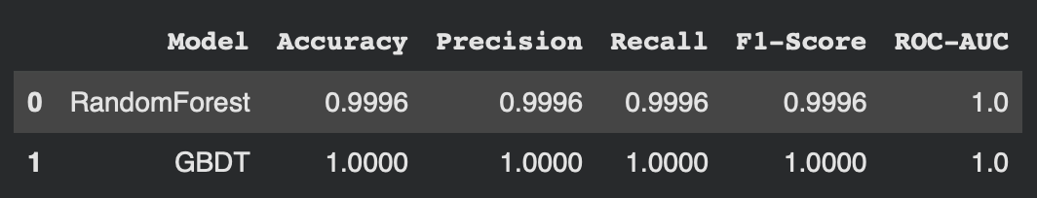
08
💡Supervised Learning Findings
Models Tested:
Key Results:
Gradient Boosting (GBDT)
Both models achieved near perfect performance on all metrics
Random Forest
GBDT selected as the final predictive model due to flawless classification and strong generalization

Slide 10
09
💡Unsupervised Learning Findings
Method Used:
Key Results:
K-Means Clustering
K-Means was applied after removing the class label to explore natural group patterns in the fleet.
K = 10 was selected based on the Elbow and Silhouette evaluation trends.
The resulting clusters reflect different operational and maintenance usage behaviors across vehicles.

Slide 11
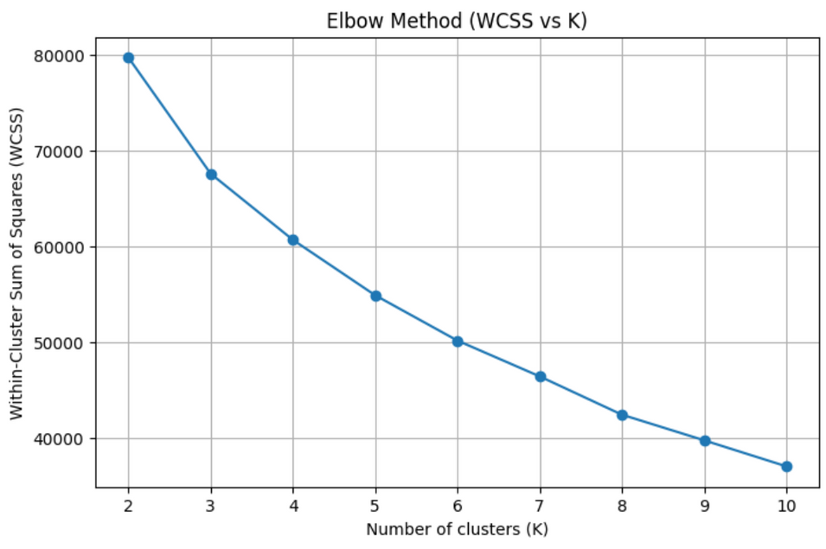
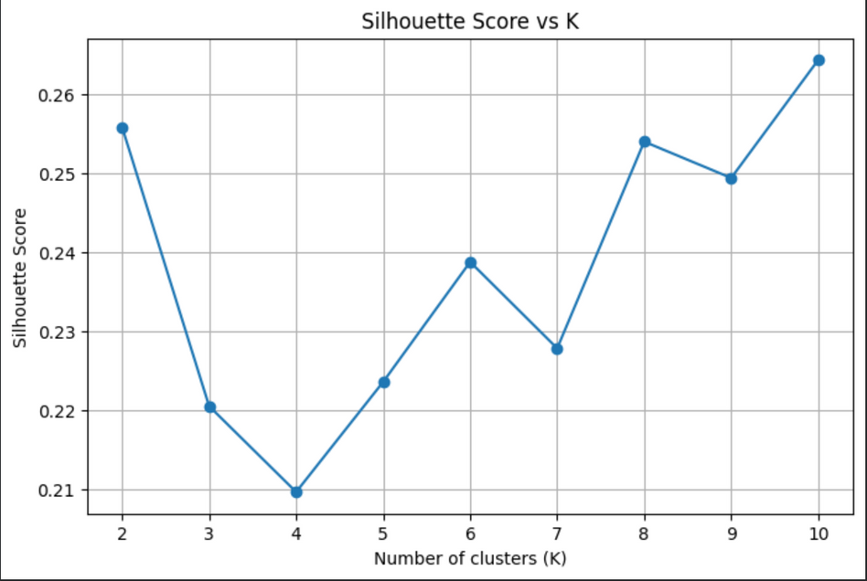
10
Key Results:
Elbow Method
Silhouette Score VS K

Slide 12
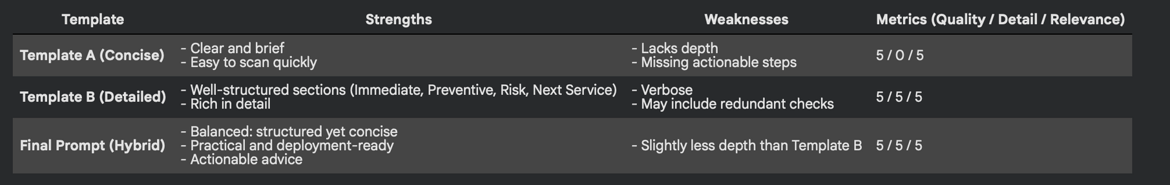
11
💡Generative AI Integration Findings
Models Used: TinyLlama-1.1B - Microsoft Phi-2
Templates:
Template A – Concise Advice
Template B – Detailed Advice
Template Hybrid
Generates short and quick maintenance advice in 1–2 lines
Provides structured, expert-level guidance with multiple sections
Balanced Prompt:

Slide 13

12
Conclusion & Recommendations
  Key Insights
  Actionable Recommendations
Data consistency and preprocessing proved essential: cleaning, standardizing, and handling missing values significantly improved model reliability and performance.
Deploy the GBDT model as the core predictive engine, with continuous monitoring of performance.
Use clustering results to categorize vehicles into risk groups and tailor maintenance schedules accordingly.
Integration of supervised and unsupervised methods provided complementary perspectives: predictive models delivered accuracy, while clustering uncovered hidden operational patterns that validated and enriched the analysis.
Integrate explainability tools (e.g., SHAP, cluster reports) into dashboards to build trust among technicians and managers.

Slide 14



13
Conclusion & Recommendations
  Future Work
Optimize predictive thresholds by balancing breakdown costs against maintenance costs.
Conduct field experiments to measure the real-world impact of the model on reducing breakdowns and operational costs
Enrich the dataset with additional indicators such as driving style and environmental conditions.

Slide 15


14
Lessons Learned
Signal strength matters more than feature quantity; a few strong indicators proved more impactful than dozens of weaker ones.
Addressing class imbalance is critical to ensure fairness and prevent bias toward one category.
Data consistency is essential for the success of any model; cleaning and standardization directly improve results.

